Slide 1
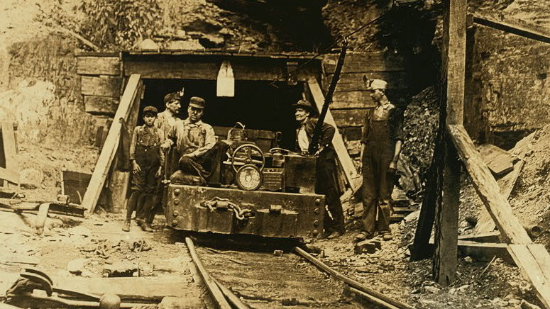
Class 9:
Mining
Cryptocurrency Café
UVa cs4501 Spring 2015
David Evans

Slide 2
Plan for Today
Quiz
Bitcoin (PointCoin) Mining
Cost of Computing
Mining

Slide 3
Analyzing Cost
int gaussSum (int m) {
int sum = 0;
for (int i = 1; i <= m; i++) {
sum = sum + i;
}
return sum;
}
cs2110/cs2150
What is the cost of this function?

Slide 4
Analyzing Cost
int gaussSum (int m) {
int sum = 0;
for (int i = 1; i <= m; i++) {
sum = sum + i;
}
return sum;
}
cs2110/cs2150
What is the cost of this function?

Slide 5
Analyzing Cost
int gaussSum (int m) {
int sum = 0;
for (int i = 1; i <= m; i++) {
sum = sum + i;
}
return sum;
}
In Reality:
What is the “cost” of this function?

Slide 6
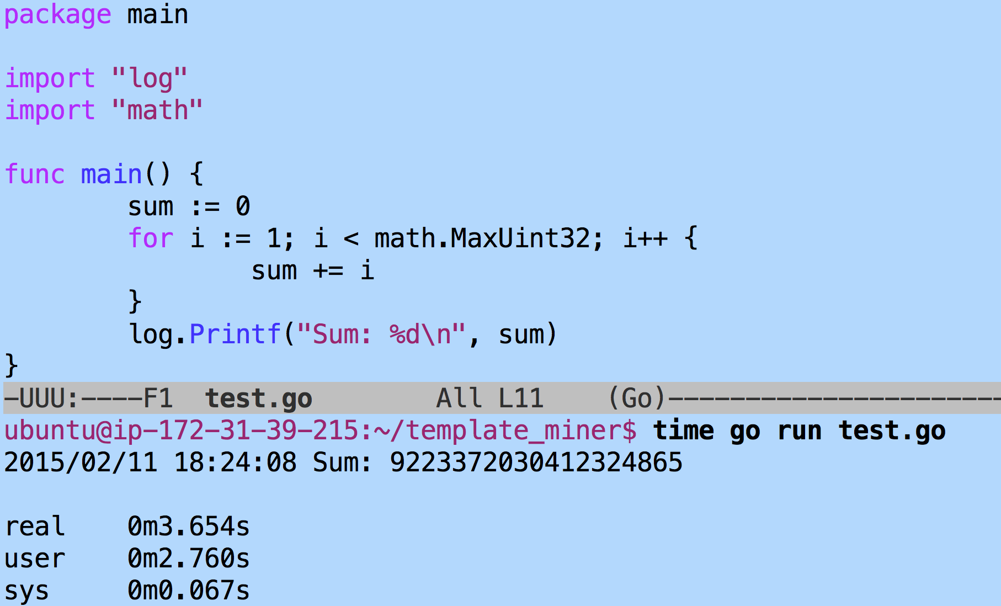
> !javac
javac gaussSum.java
> time java gaussSum
2147483647
4294967295

Slide 7
Cost of Mining
Setup:
block := construct next block header
difficulty := next difficulty
One attempt:
block.Header.nonce += 1 // guess next nonce
hash, _ = block.Header.BlockSha()
if hash < difficulty { Success! }

Slide 8
package main
import "github.com/PointCoin/fastsha256"
import "log"
import "time"
func main() {
msg := "test"
hasher := fastsha256.New()
hasher.Write([]byte (msg))
starttime := time.Now()
num := 10000000
for i := 0; i < num; i++ {
hasher.Sum(nil) // ignore result
}
elapsed := time.Since(starttime)
log.Printf("Total time: %s", elapsed)
log.Printf("Average hashing time: %d ns", elapsed.Nanoseconds() / int64(num))
}

Slide 9
ubuntu@ip-172-31-39-215:~/template_miner$ go build timer.go
ubuntu@ip-172-31-39-215:~/template_miner$ ./timer
2015/02/11 16:50:42 Result: 9f86d081884c7d659a2feaa0c55ad015a3bf4f1b2b0b822cd15d6c15b0f00a08
2015/02/11 16:50:50 Total time: 7.650548619s
2015/02/11 16:50:50 Average hashing time: 765 ns
ubuntu@ip-172-31-39-215:~/template_miner$ time ./timer
2015/02/11 16:50:55 Result: 9f86d081884c7d659a2feaa0c55ad015a3bf4f1b2b0b822cd15d6c15b0f00a08
2015/02/11 16:51:03 Total time: 7.676091298s
2015/02/11 16:51:03 Average hashing time: 767 ns
real 0m7.681s
user 0m8.541s
sys 0m0.131s
ubuntu@ip-172-31-39-215:~/template_miner$
2.5 GHz processor on
M3.large EC2 node

Slide 10
Cost of Mining
Setup:
block := construct next block header
difficulty := next difficulty
One attempt:
block.Header.nonce += 1 // guess next nonce
hash, _ = block.Header.BlockSha()
if hash < difficulty { Success! }
How long will it take to find a block using free EC2 nodes?

Slide 11
Free Money?
>>> difficulty = 44455415962
>>> hashes_expected = difficulty * 2**32
>>> hashes_expected
190934557686866378752L
>>> nanos_needed = hashes_expected * 760 # ns per hash
>>> seconds = nanos_needed / 10**9
>>> seconds
145110263842018L
>>> days = seconds / (60 * 60 * 24)
>>> days
1679516942L
>>> years = days / 365
>>> years
4601416L
>>> years * 2
9202832L

Slide 12
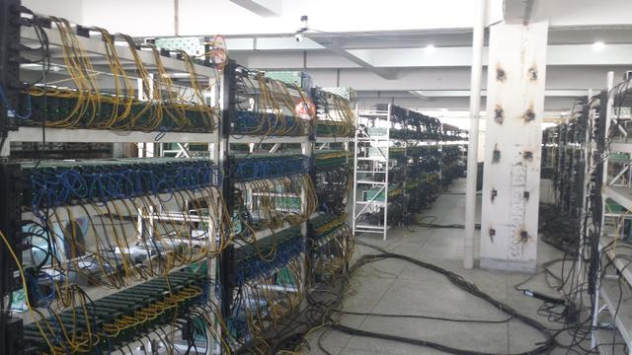
Image from: http://www.thecoinsman.com/2014/08/bitcoin/inside-chinese-bitcoin-mine/

Slide 13
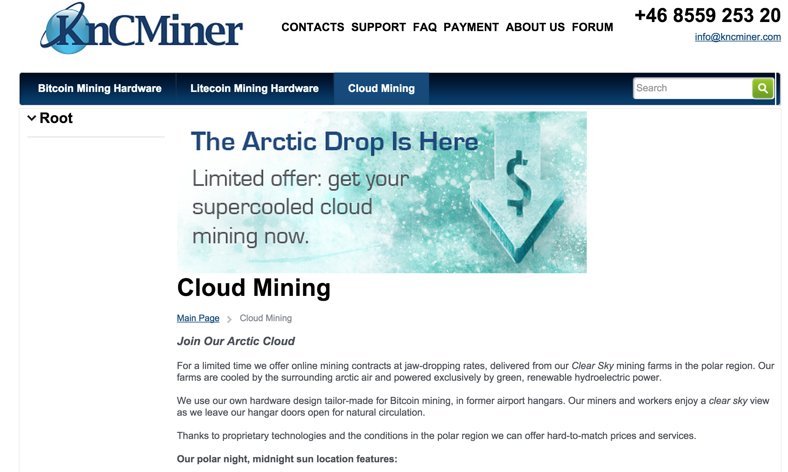

Slide 14
Why is energy/hash so much less for custom ASICs?

Slide 15
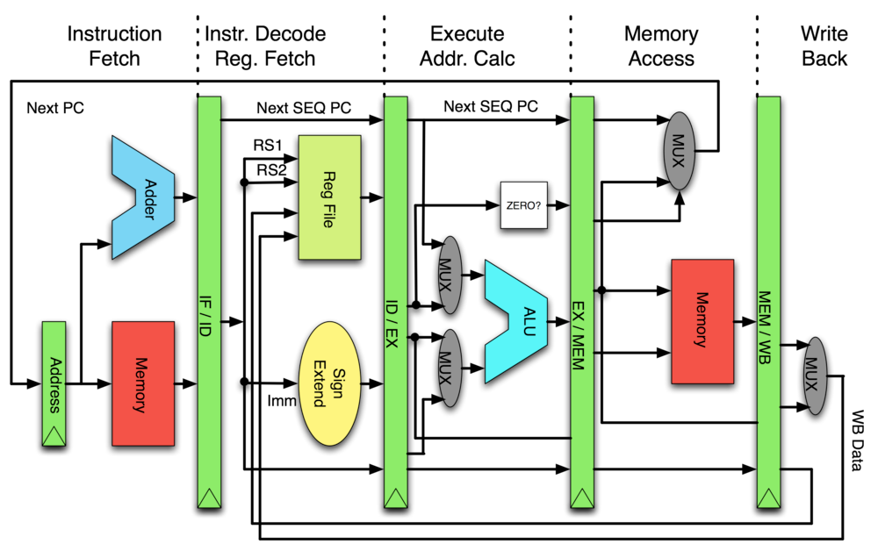
XOR two 32-bit values in CPU
XOR two 32-bit values in ASIC

Slide 16
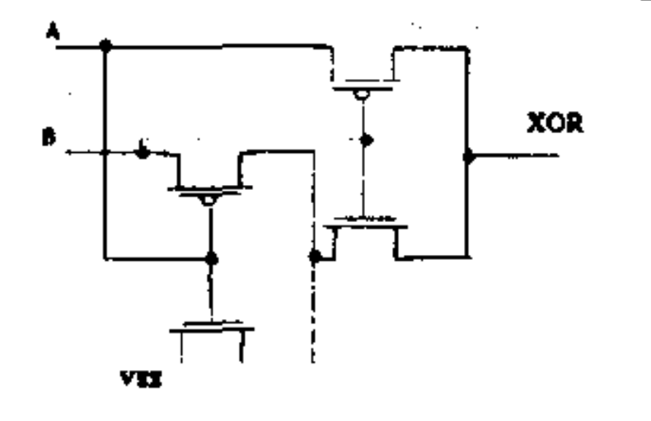
4 transistors XOR design
XOR two 32-bit values in CPU
XOR two 32-bit values in ASIC

Slide 17
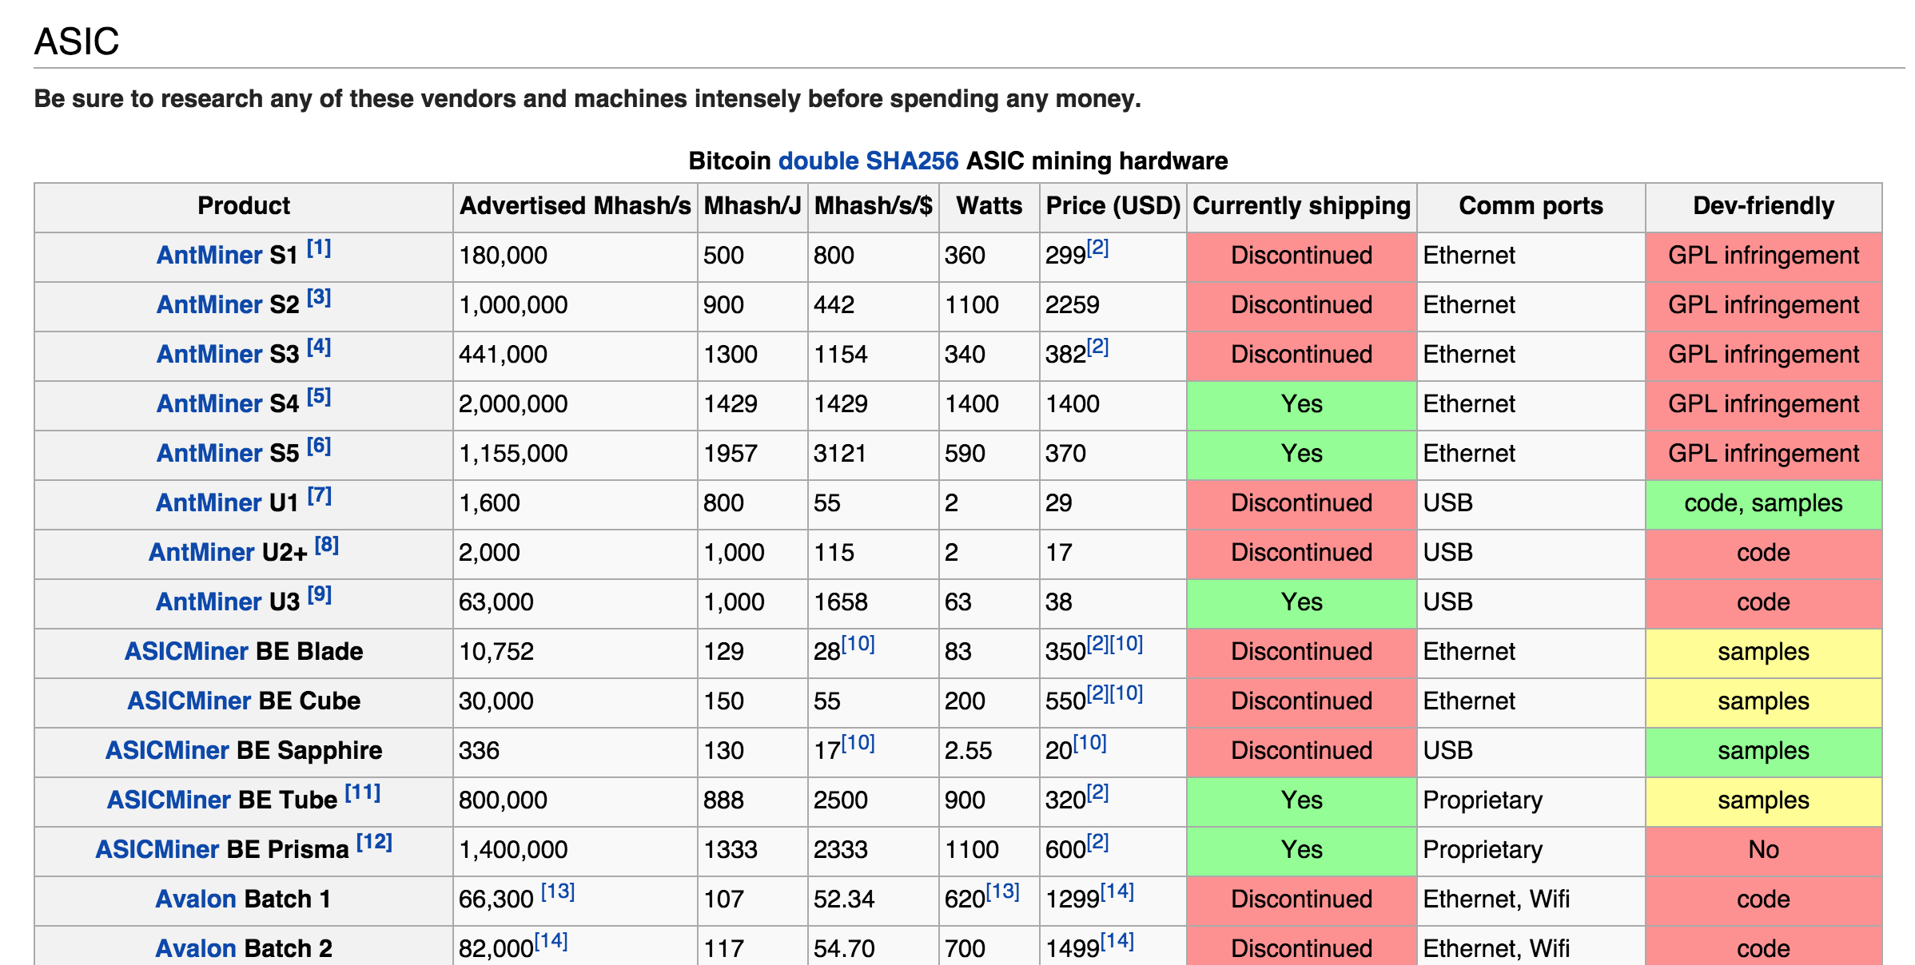
https://en.bitcoin.it/wiki/Mining_hardware_comparison
1J ~ “lift an apple one meter”

Slide 18
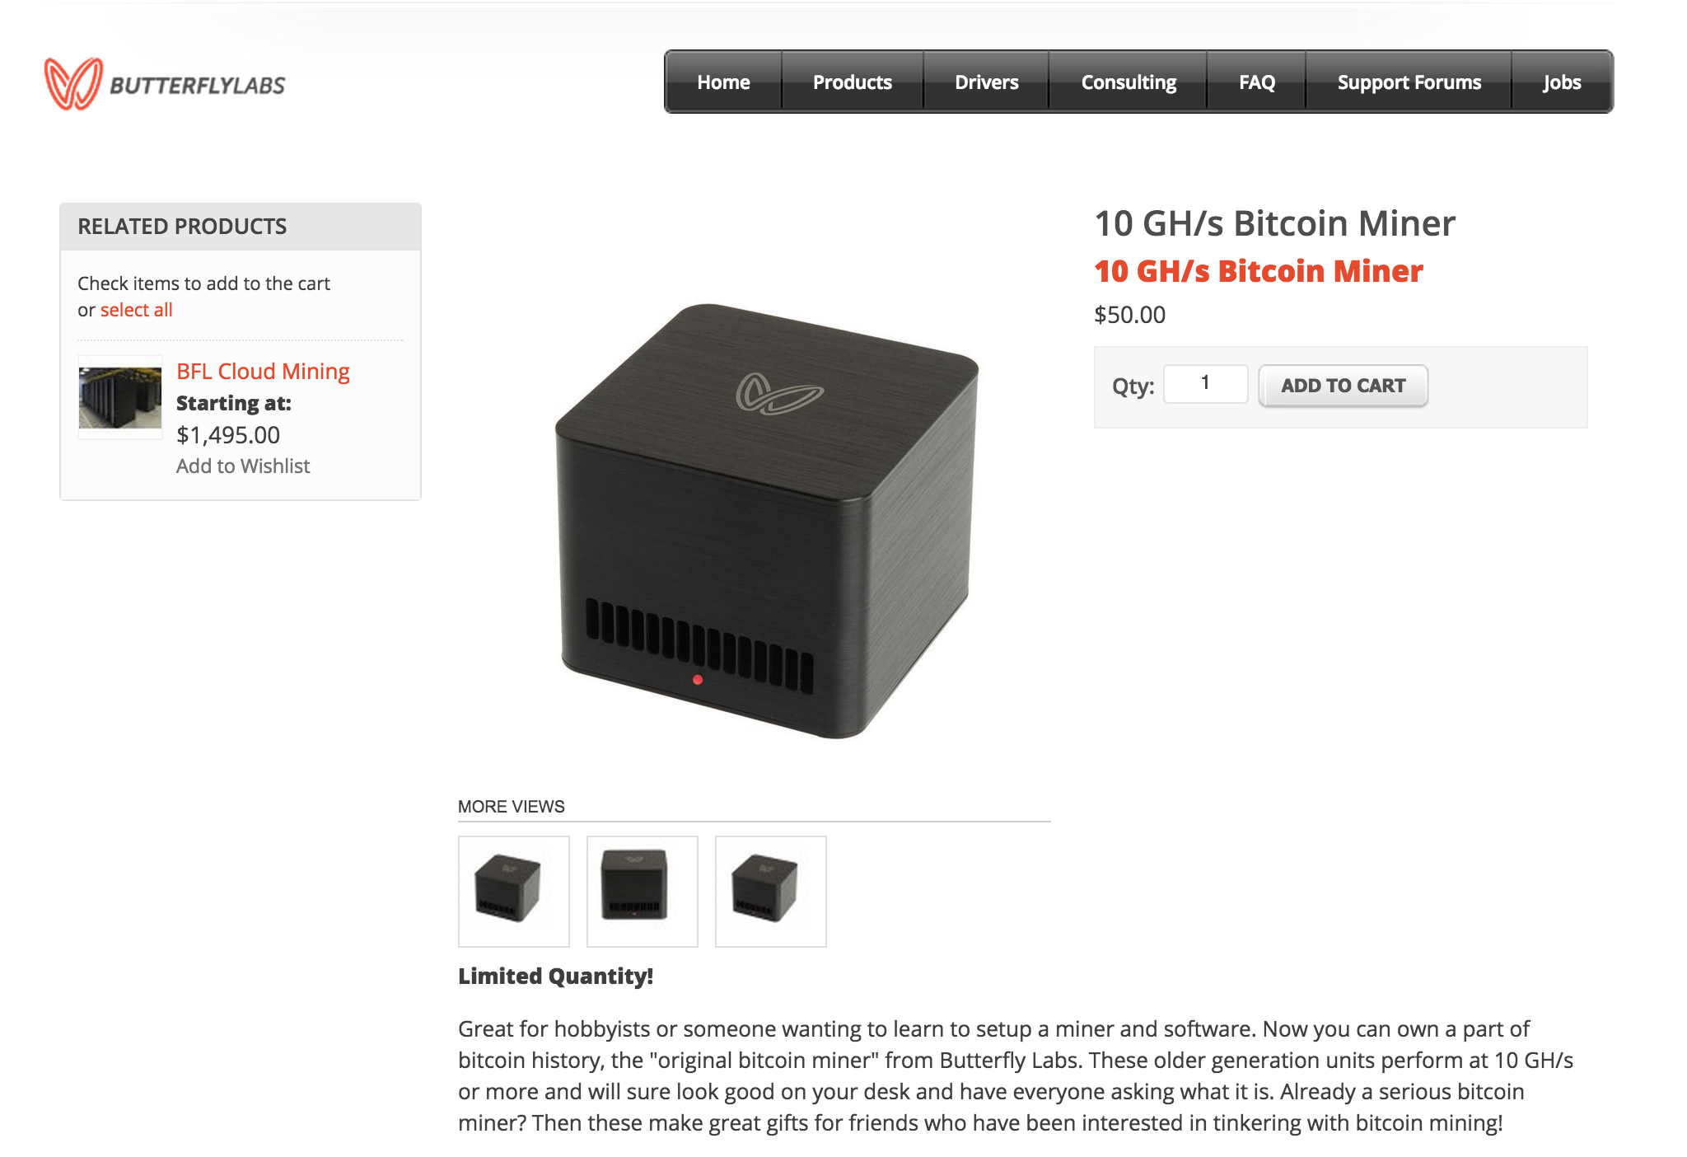
>>> 10**9/(760 * 2)
657894
= 0.0006 GH/s

Slide 19
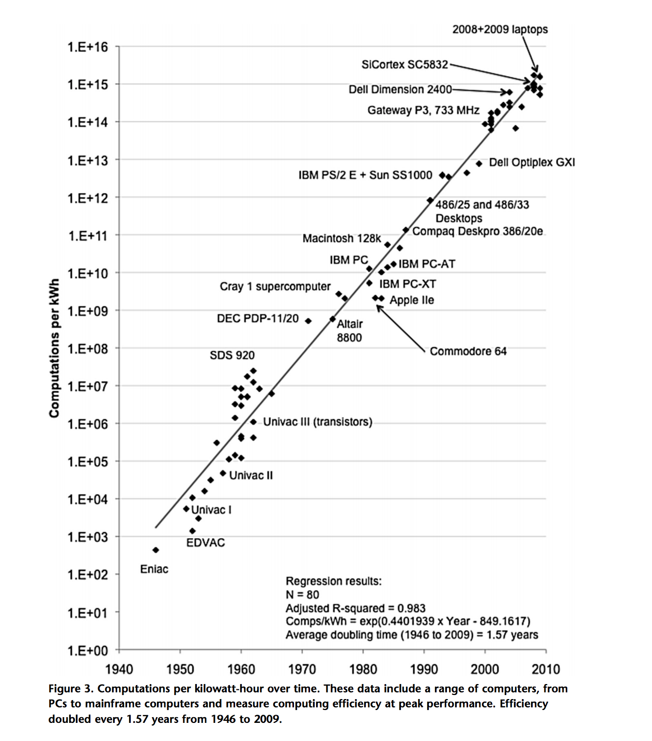
Koomey’s Law

Slide 20
Charge
Project 2: starting code and hints for your miners will be posted tonight
Read: Chapter 8: Mining and Consensus
Next week:
Start thinking about your projects
Attacks on bitcoin
Later:
Anyway to make a cryptocurrency without wasting all that energy?

